Slide 1
Agile is NOT Dead
Michelle Brud, Director, Technology Delivery

Slide 2
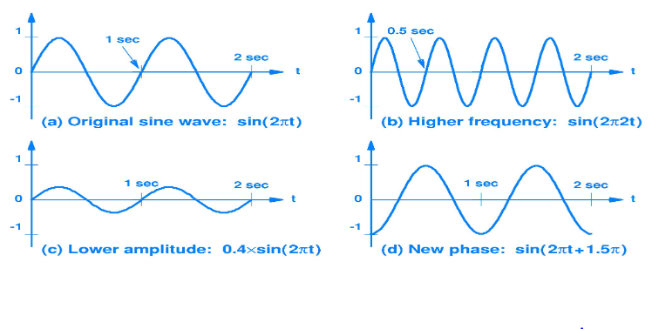
You should know……..I’m wired for agile!!

Slide 3
The Narrative:
Agile is Dead
Many in the Agile industry are questioning its relevance—not because the principles are wrong, but because the implementations have become rigid, commoditized, or misunderstood.

Slide 4
My thoughts…..
        How did Agile get a bad rap?
Agile has become a buzzword, not a mindset
Failed transformations fuel skepticism
Rigid frameworks are blamed for killing agility
Agile is alive—but misunderstood
The market is shifting toward outcomes, not frameworks
“Agile is not a plug-and-play package that involves rituals and practices. Being Agile requires a sustained commitment to changing behaviors, structures, and mindsets throughout the entire organization.” - HyperDrive

Slide 5
Core Principles
        Empiricism: learning by doing
        Transparency: making work/challenges visible
        Adaptation: responding to change
Scrum Guide = compass, not a cage

Slide 6
How it starts…….
Teams start with Scrum Guide practices
Sprint‑over‑sprint learning
Adaptation to organizational ecosystem
“Teams begin with the basics. Sprint after sprint, they learn. They adapt to constraints, culture, and systems. That’s Agile in the wild.”

Slide 7
Why does Agile work?
“Agile frameworks help employees feel connected to the organization. By working together in short cycles, they build relationships and trust.” Software leader, WPS
Agile supports strategic priorities
Culture
  Human Resources’ TOMO scores increased by 8 points since start of Agile transformation.
    These results were driven by implementing Scrum values which closely align with WPS values and by empowering teams to figure out the best way to approach their work.
Profitability
  Throughput, morale increased for the Scrum teams from 2019 to current date.
    These results were driven by product definition, strong Product Ownership, and leadership’s focus on removing impediments & empowering the teams
Growth
  Product teams should be established to support new contracts
Michelle

Slide 8
The proof that Agile is alive and evolving……..
Daily standups → Slack chat
Retrospectives → tailored formats
Features → Outcomes

Slide 9
WPS proves Agile thrives in product delivery
Agile adapts to context
Scrum Guide = compass, not cage
Agile is not dead — it’s evolving
Embrace Change
“Agile adapts. The Scrum Guide is a compass, not a cage. And WPS shows Agile is alive and well in product delivery.”

