Slide 1

Applying Lean UX Practices
From Resistance to Results
Derek Bressler | Head of Software Engineering & CX | 12/04/2025

Slide 2

Derek Bressler, Head of Software Engineering & CX
Aptargroup, Inc. – aptar.com
Email: derek.bressler@aptar.com
LinkedIn: www.linkedin.com/in/derek-bressler

Slide 3
An Introduction to Aptar
Demystifying DevOps: A Manager’s Journey

Slide 4
Global Presence
Over 13,000+ dedicated employees in 20+ countries
Europe: 62% Asia/LATAM: 20% North America: 18%
4

Slide 5
Global Leader in Drug and Consumer Product Dosing, Dispensing and Protection Technologies
2024 % of Total Reported Sales
  FY 2024 Net Sales by Ship To Destination
Beverage
49%
Food
Proprietary Drug Delivery Systems²
32%
Closures
11%
Home Care
8%
Beauty
Personal Care
Pharma
Significant history and global presence enables us to build solid and lasting credibility with regional and global powerhouse customers
  Over 5,000 customers worldwide
  Many of the world’s leading brands
Injectables
Beauty
Active Material Science Solutions
1: 2024 Annual Revenue
2: Proprietary Drug Delivery Devices includes Prescription, Consumer Healthcare and Digital Health Markets
3: See “Forward-Looking Statements and Non-GAAP Financial Measures” slide for definitions and Appendix for GAAP reconciliation
4: Segment percentages calculated as the percentage of Adjusted EBITDA for Reportable Segments

Slide 6

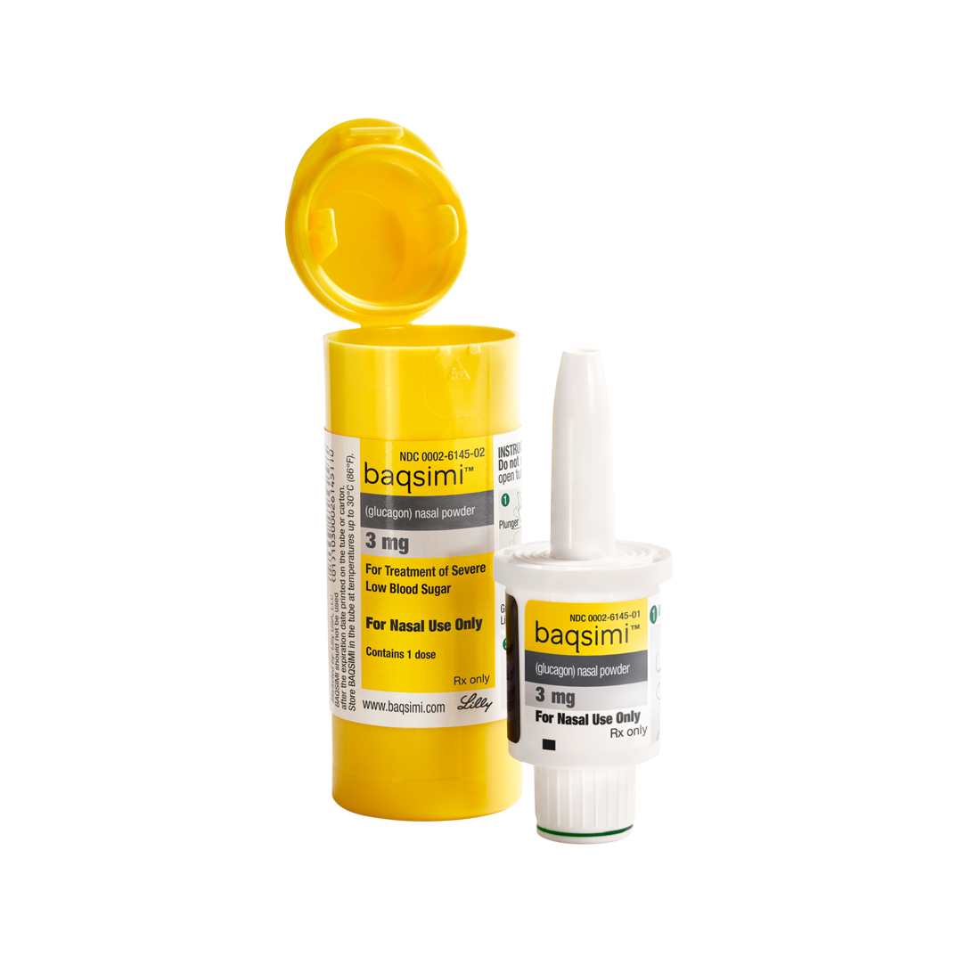
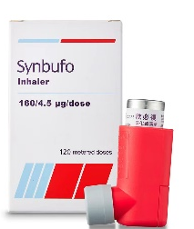
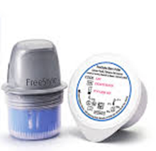


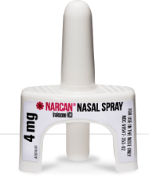
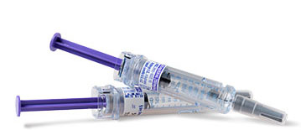





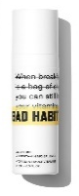




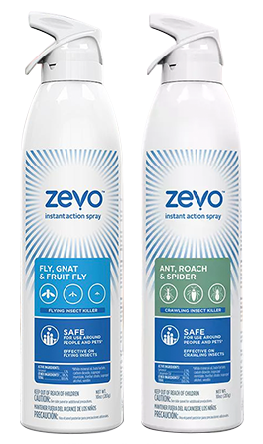

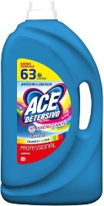
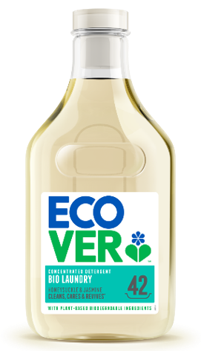
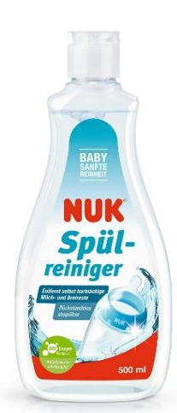







Millions of People Around the World Use our Products Every Day
6
Notes:
Our products and solutions are everywhere and part of our daily lives.
You should feel proud about working for Aptar as you’re truly making a difference in the lives, looks, health and homes of millions of people around the world.

Slide 7

Setting the stage…
A user comes to you with a problem—and the perfect solution already in mind.
They hand over a massive specification document, fully detailed and polished.
You pass it to your developers.
3–6 months later, the application is built and handed over to the users.
Then What Happens?
Maybe it goes live… maybe it doesn’t.
Either way, the result is the same:
  Users complain.
  It’s barely used.
  The application fails.

Slide 8


Slide 9


Why Does This Keep Happening?
Symptom Fixation:
End users often focus on visible symptoms instead of uncovering the root cause.
Narrow Perspective:
Key users closest to the issue may ignore broader needs or perspectives of less familiar users.
Developer Limitations:
Developers do their best—but most are not trained in UX or UI design, leading to functional but frustrating experiences.
Lack of Iteration:
Traditional processes aim for perfect upfront design, leaving little room for feedback and adjustment.
Visual Gap:
Users often need to see something tangible—a prototype or mockup—to fully conceptualize the solution and provide meaningful feedback.
What if there was a way to uncover real problems, validate ideas early, and design with confidence?

Slide 10

Lean UX: Core Values
Focus on Outcomes, Not Outputs
Shift from “building features” to solving real user problems.
Collaborative & Cross-Functional
Break down silos—design, dev, and business work together from day one.
Rapid Experimentation & Iteration
Build MVPs and prototypes early, validate ideas quickly, and adapt based on feedback.
Continuous Learning
Treat every design as a hypothesis to test, not a final answer.
User-Centered & Evidence-Driven
Decisions based on real user insights, not assumptions or lengthy specs.
Lightweight Documentation
Spend less time writing specs, more time creating and validating solutions visually.

Slide 11
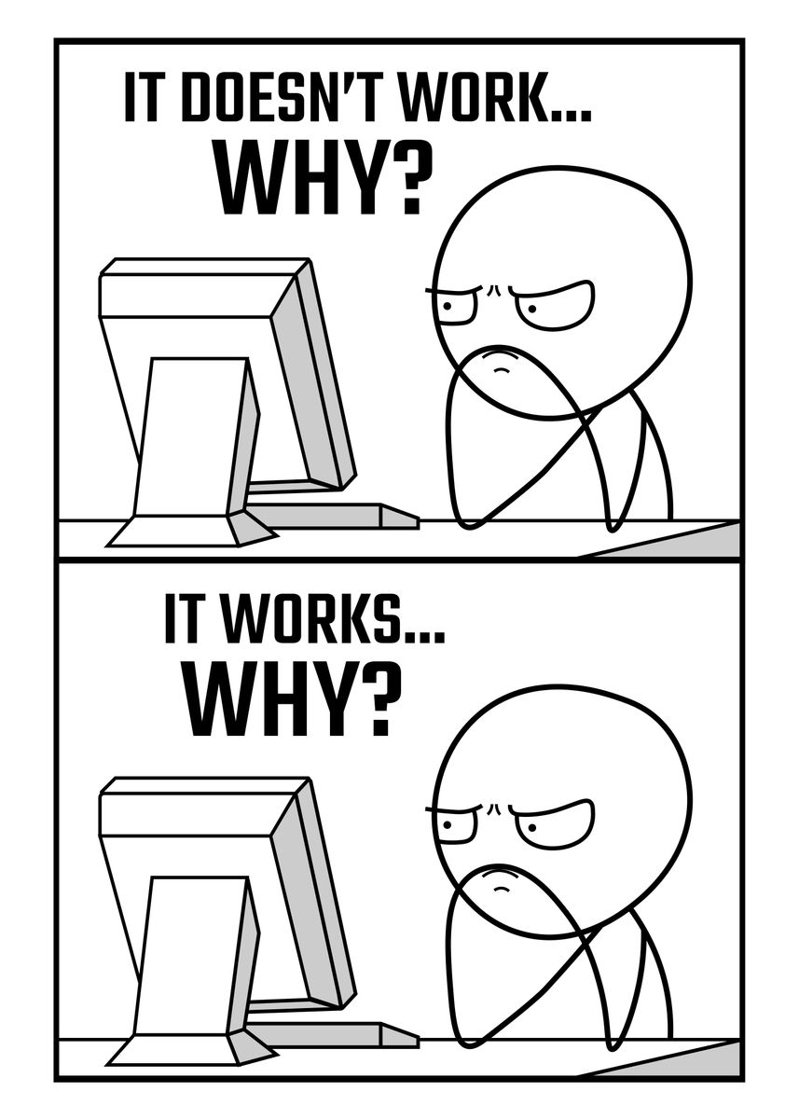
Why Does it Work to Solve Problems?
Uncovers Root Causes:
Lean UX starts with research and discovery, ensuring we solve the real problem, not just symptoms.
Brings Broader Perspectives:
Continuous feedback loops involve multiple user types, preventing tunnel vision from key stakeholders.
Gives Developers Clear Direction:
Validated prototypes and iterative designs provide clarity and confidence, reducing guesswork.
Visualizes Solutions Early:
Users see wireframes and prototypes early, making feedback meaningful and actionable.
Reduces Risk of Failure:
Testing ideas before heavy investment means fewer surprises at launch and higher adoption rates.
Accelerates Learning & Delivery:
Short cycles and MVPs allow teams to learn fast and adapt, instead of waiting months for feedback.

Slide 12

Lean UX in Action: Aptar Distributor Portal
Project Goal: Provide Aptar’s distribution customers online self-service access to pricing, engineering drawings, and stocking programs.
Total Timeline: 6 months from concept to launch.
Lean UX Phase (First 6 Weeks):
Workshops: 1–2 per week to deep dive into real problems, not just perceived symptoms.
User Collaboration: Direct engagement with distributors and internal teams.
Prototyping:
  Weeks 4–6: Iterated low-fidelity wireframes → high-fidelity mockups with users.
  Gathered feedback early and often.
Impact:
Entered 4.5-month development phase with a clear plan and shared understanding between users and developers.
Addressed true root causes of servicing distributors, avoiding wasted effort on superficial fixes.
Delivered a solution that met real user needs and gained rapid adoption.

Slide 13
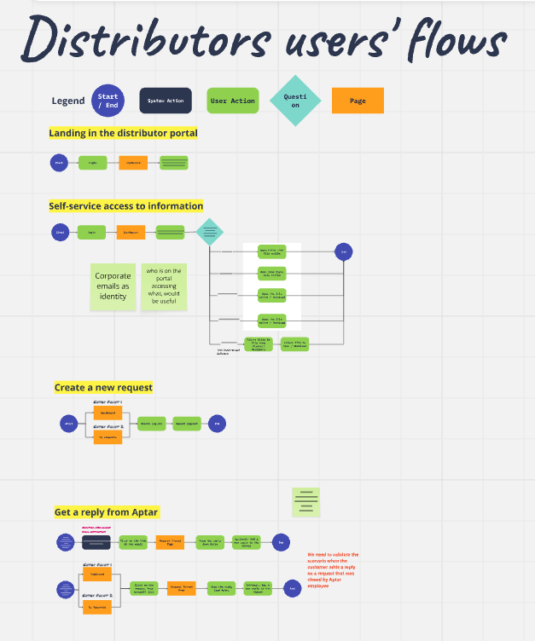
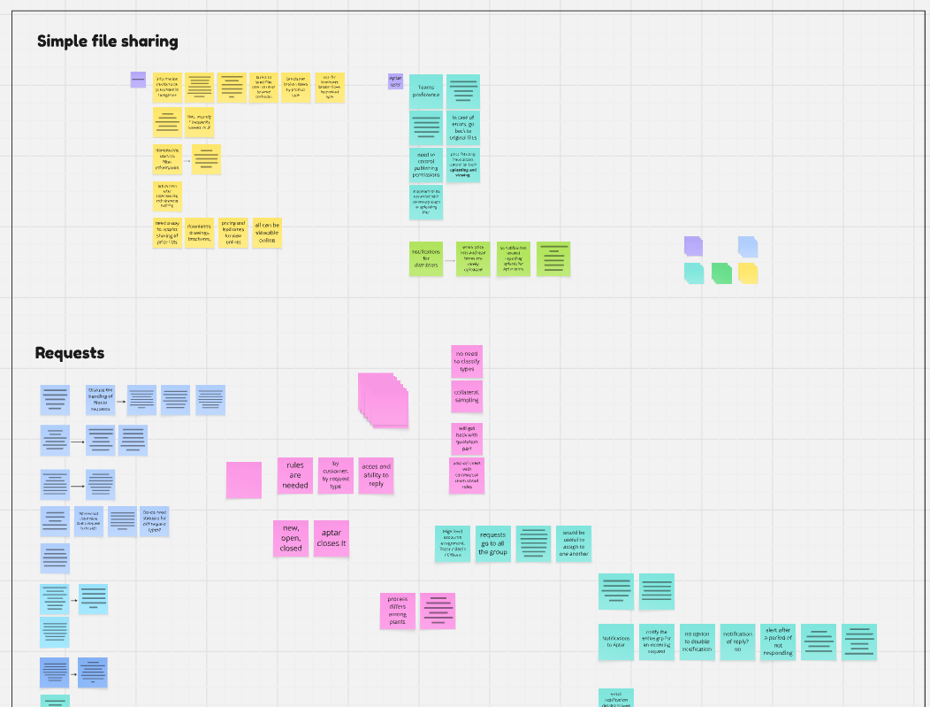
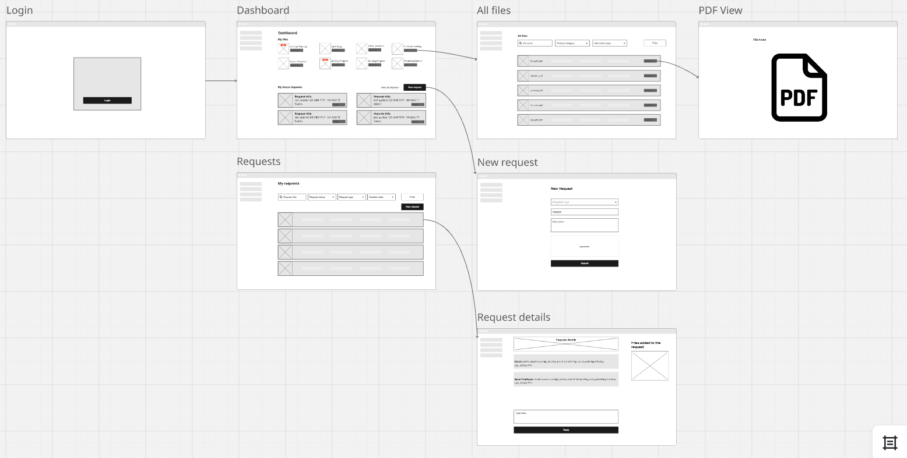
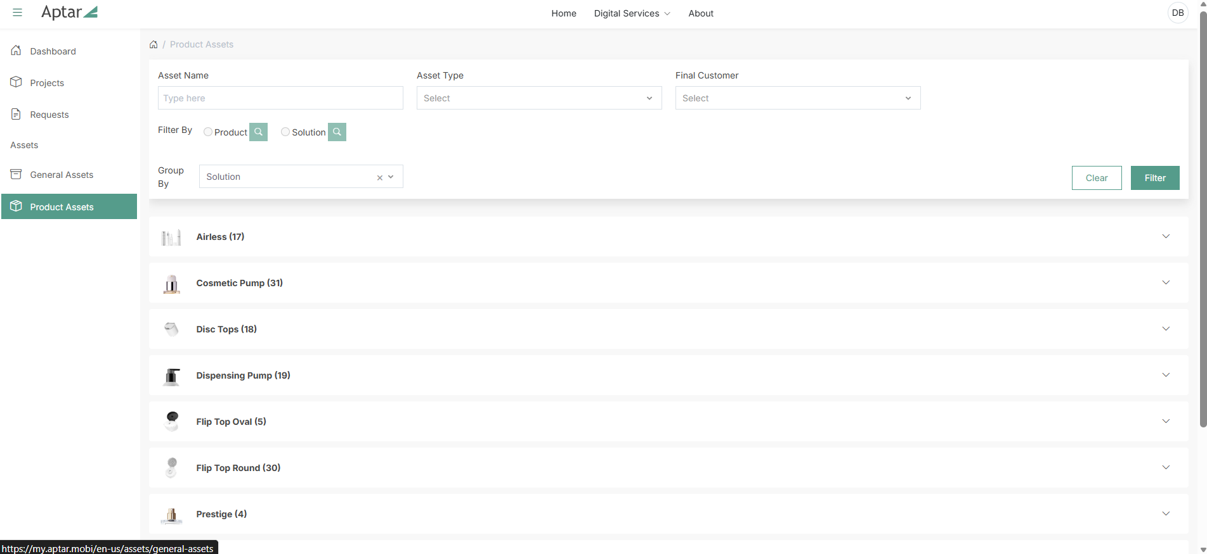
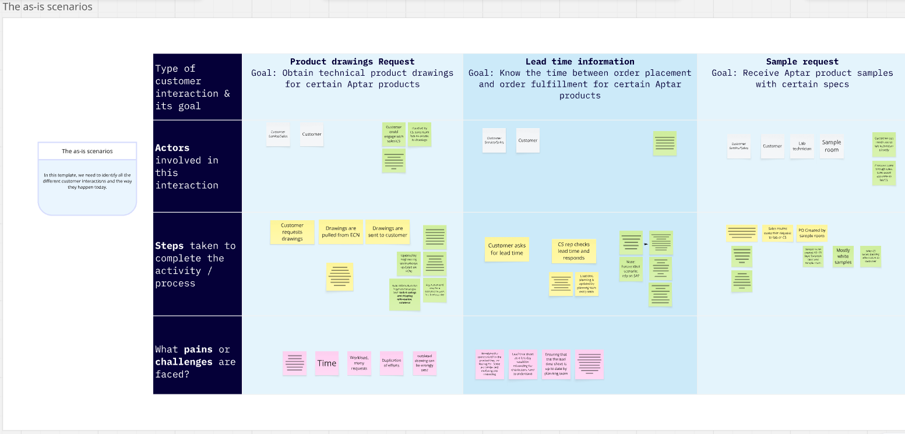
What Does it Actually Look Like?

Slide 14

Practical Tips for Lean UX Success
Start Small, Prove Value
Begin with a pilot project or a single feature to demonstrate impact.
Engage Stakeholders Early
Involve business, design, and development teams from day zero to build buy-in.
Define Clear Objectives
Know what you’re trying to learn or validate before starting research or prototyping.
Prioritize Collaboration
Use workshops and shared tools (Miro, MS Whiteboard) to break silos.
Prototype Quickly & Iteratively
Start with low-fidelity wireframes, then refine based on feedback using tools like Figma.
Gather Feedback Early & Often
Create feedback loops and share insights across teams to keep alignment.
Embrace Experimentation
Treat designs as hypotheses—test, learn, and iterate without fear of failure.
Measure & Communicate Success
Track KPIs (NPS, error rates, time on task) and share results to reinforce value.

Slide 15
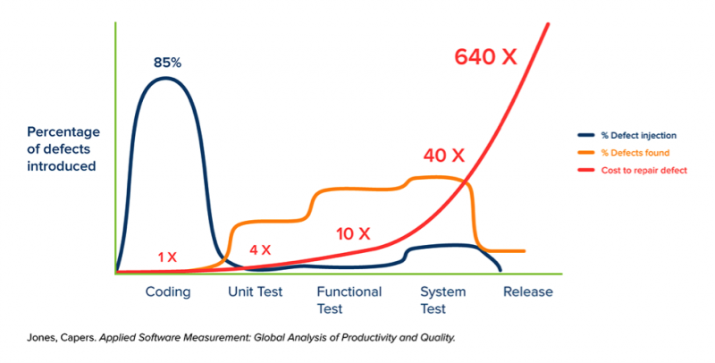
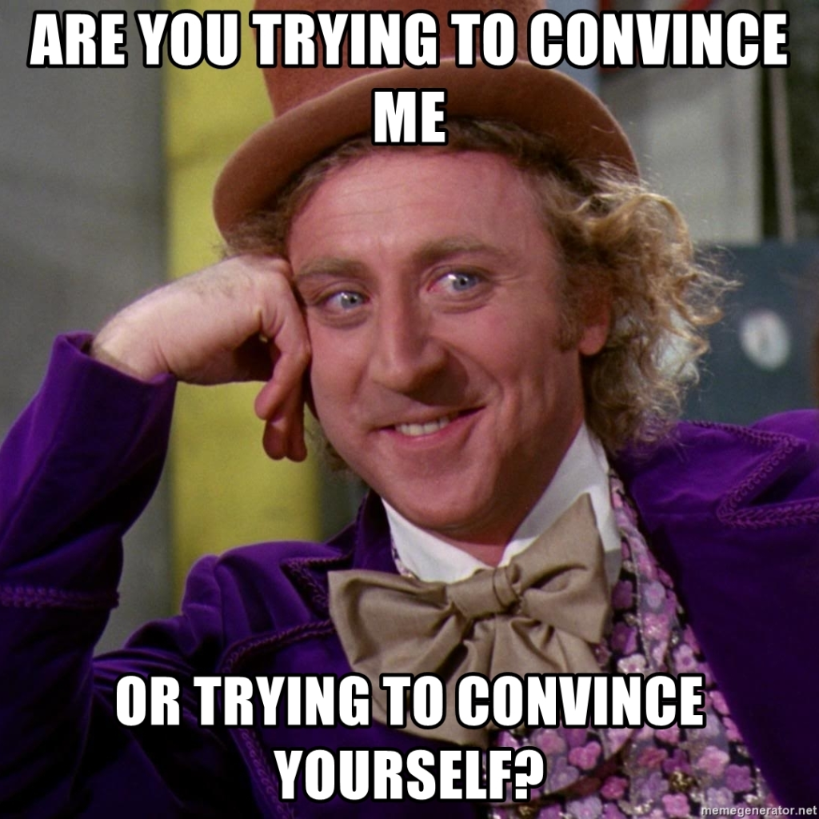
How to Win Buy-In for Lean UX
Tie Lean UX to strategic priorities:
Customer-centricity, Operational excellence, Cost efficiency
Use Success Stories & Case Studies
Real-world examples (like Aptar’s Distributor Portal) show tangible benefits.
Engage Stakeholders Early
Invite management to workshops—let them see the process and value firsthand.
Show Measurable Outcomes
Share KPIs from similar projects: Faster time-to-market, Higher adoption rates, Improved customer satisfaction (NPS)
Emphasize ROI, Not Just Cost
Upfront analysis prevents expensive rework and post-launch fixes.
Every dollar spent early saves multiples later.
Highlight the Cost of Failure
Traditional projects often waste months and millions on solutions that miss the mark.
Lean UX reduces risk by validating ideas before heavy investment.

Slide 16
Building a Lean UX Culture
Promote a User-Centered Mindset
  Make user needs the foundation of every decision.
Encourage Cross-Functional Collaboration
  Designers, developers, and business stakeholders work as one team.
Embrace Iteration & Experimentation
  Allow for failure—treat designs as hypotheses.
Provide Ongoing Training & Support
  Reinforce Lean UX principles through workshops and learning resources.
Celebrate Successes & Learn from Failures
  Share wins and lessons to strengthen adoption.
Tools & Resources for Each Step
Think (Research & Discovery):
  Tools: Miro, MS Whiteboard for workshops
  Resources: Google UX Design Professional Course (Coursera)
Make (Design & Prototype):
  Tools: Figma, Sketch, Adobe XD for wireframes and mockups
Check (Validate & Iterate):
  Tools: UserTesting, Maze for usability testing
  Metrics: NPS, success/error rates, time on task
Collaboration & Communication:
  Tools: Teams, SharePoint for sharing insights and feedback loops
Mindset + Method + Tools = Lean UX that sticks.
Notes:
Wordpress is the most used Content Management system in the world and as a technology does not have a company providing enterprise support (community support). For these reasons hackers target wordPress more than any other technology. It is a suitable technology for basic websites / online catalogs but is risky to use in more complex scenarios.

Slide 17
Lean UX isn’t just for tech companies—it’s a mindset that drives value, efficiency, and customer satisfaction.

Slide 18
Questions? Feel Free to Reach Out!
Derek Bressler, Head of Software Engineering & CX
Aptargroup, Inc. – www.aptar.com
Email: derek.bressler@aptar.com
LinkedIn: www.linkedin.com/in/derek-bressler

Slide 19

Disclaimer
This document, including all its sections, is protected by copyright.
Any use of the contents outside the narrow limits set by the copyright law is illegal and liable to prosecution if the author's permission has not been sought.
This applies in particular for reproducing, translating, microfilming, storing and processing the contents in electronic systems.
In addition, this document and any printed materials resulting from this document are confidential, should be used for internal use only and should not be shared with third parties without Aptar’s prior written consent.

Slide 20



Follow us on:
265 Exchange Drive
Suite 100
Crystal Lake, IL 60014
+1-815-477-0424
Aptar.com

