Slide 1
The Hidden tech behind casino glamour: helping to create a lasting user experience
Adam Gruszcynski
IT Director
Potawatomi Casino | Hotel Milwaukee

Slide 2
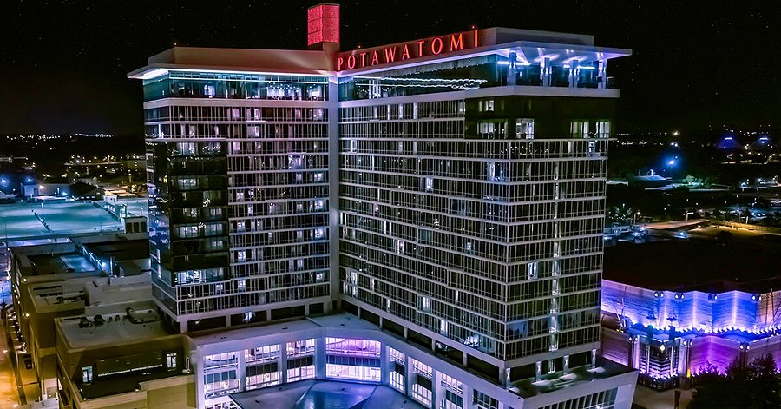
Potawatomi Casino | Hotel
Midwest’s number 1 entertainment destination!

Slide 3
IT Department
IT Operations Support
IT Field Services Support
IT Security
Network
Systems
Applications

Slide 4
The Philosophy
Enhances the guest experience
Make the organization more efficient so it can offer a better guest experience

Slide 5
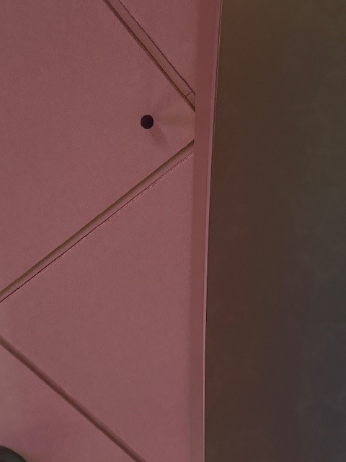
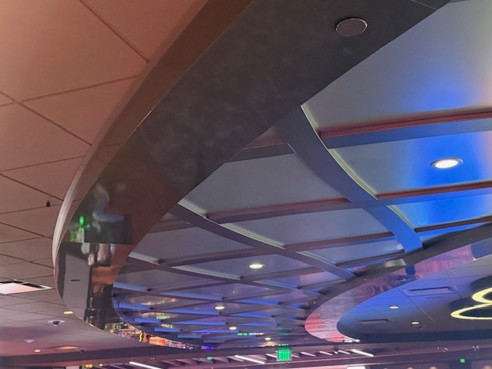
Music
Yes, something this simple is this important!
Entrances & Elevators

Slide 6
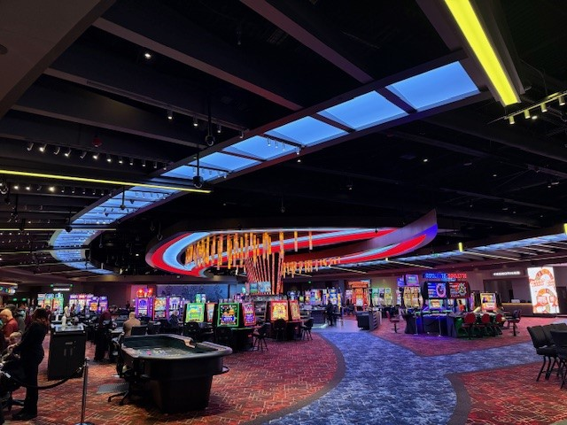
Lighting
3 colors to avoid in restaurants
Managing lighting

Slide 7
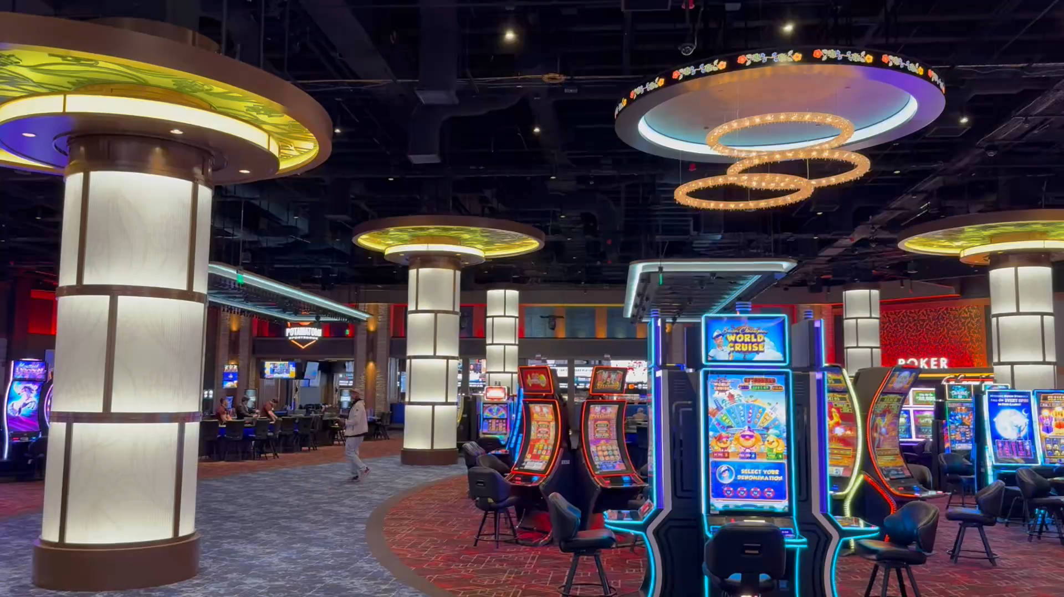

Slide 8
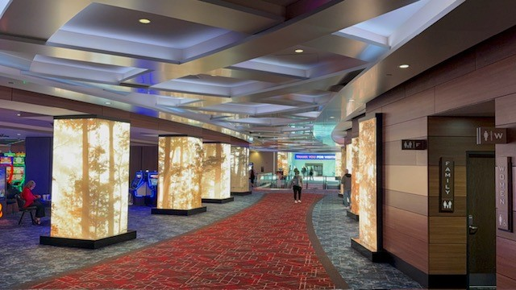
LED Columns

Slide 9
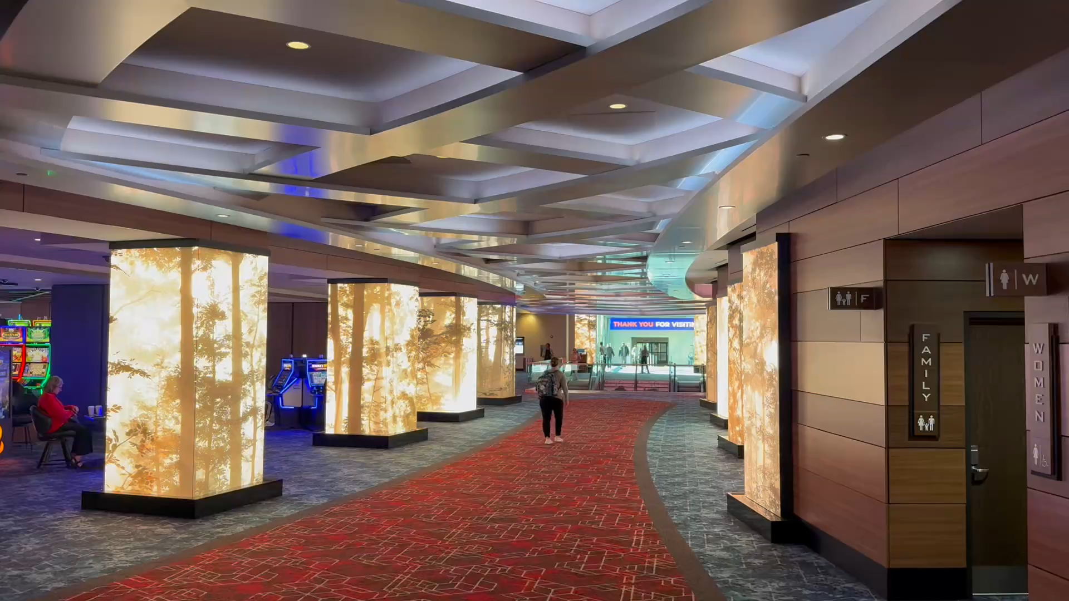

Slide 10
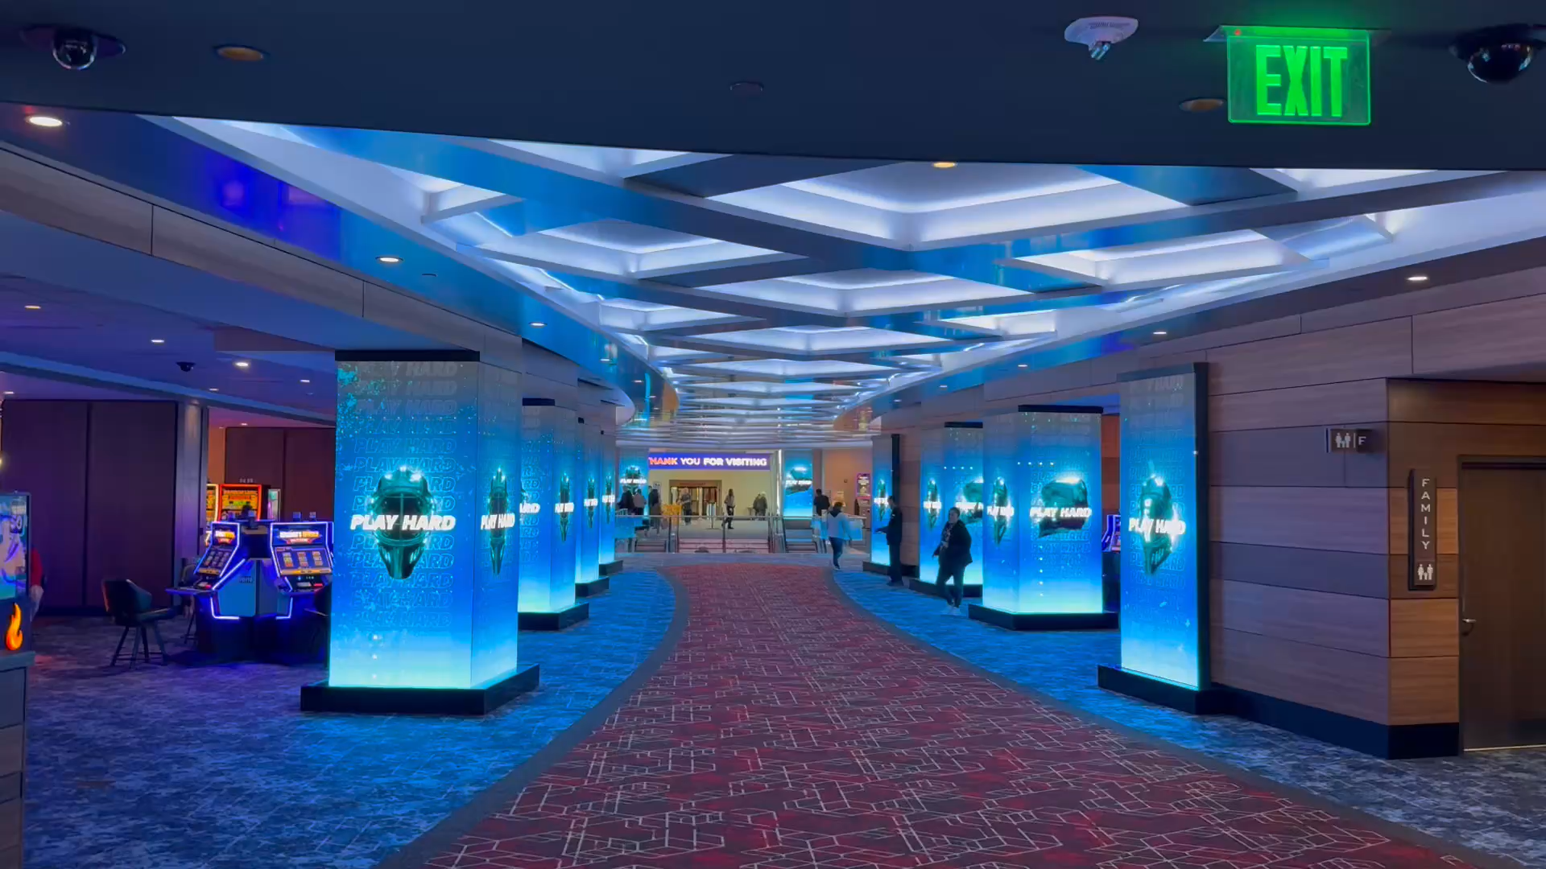

Slide 11
PCH – So Fresh AND So Clean!
Laundry received: 7,000
Laundry going out: 7,000
Alterations and repairs: 200
Issuing uniforms: 900
Receiving uniforms: 1,000
*Weekly average for Wardrobe Department

Slide 12
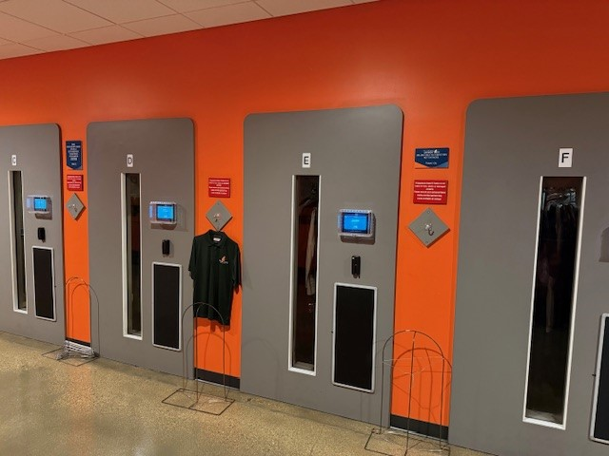
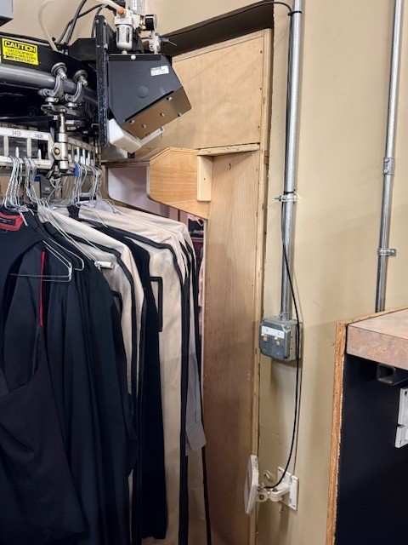
Access Doors + RFID

Slide 13
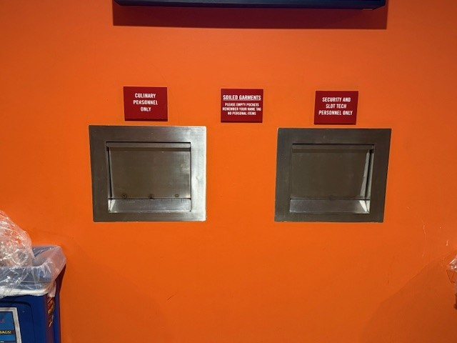
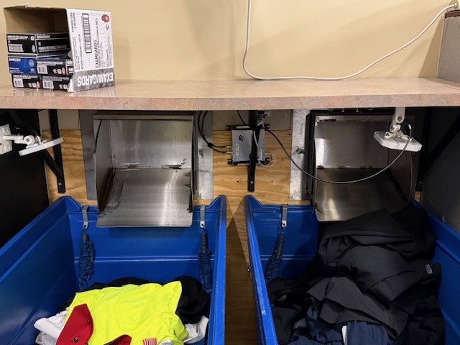
Return Shoots + RFID

Slide 14
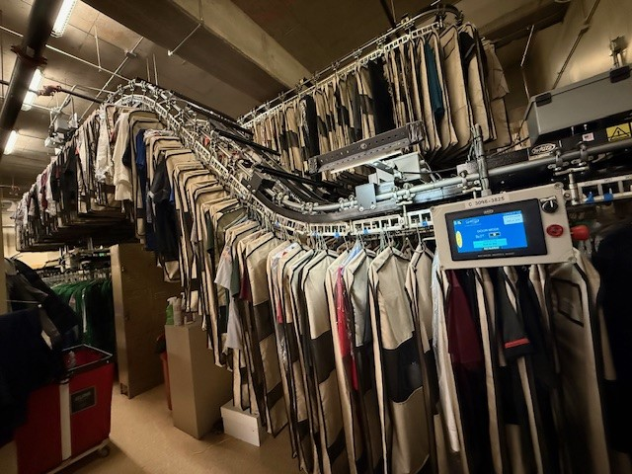
Conveyor

Slide 15
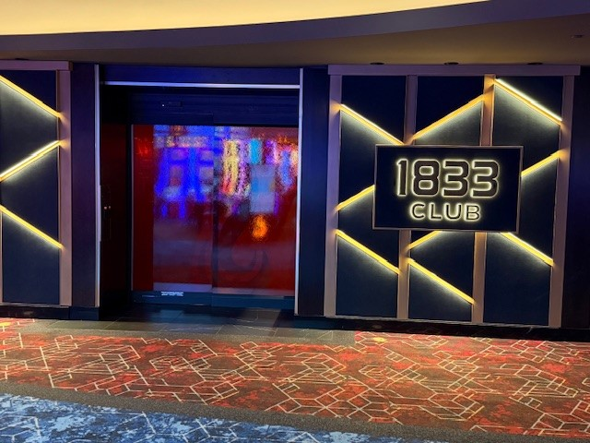
1833 Club – Door Access System

Slide 16
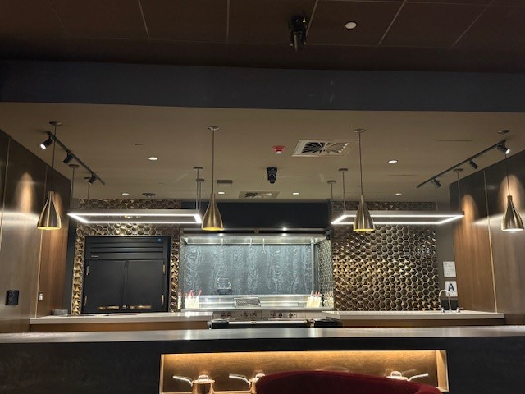
1833 Club – The Kitchen

Slide 17
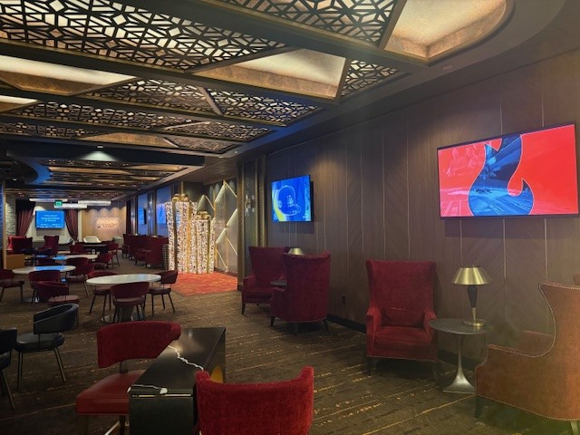
1833 Club - TVs

Slide 18
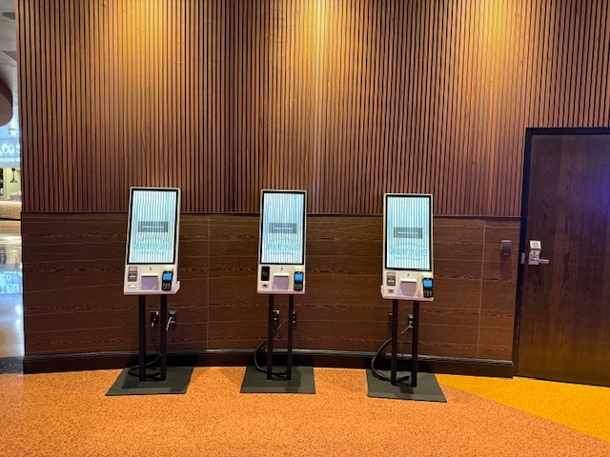
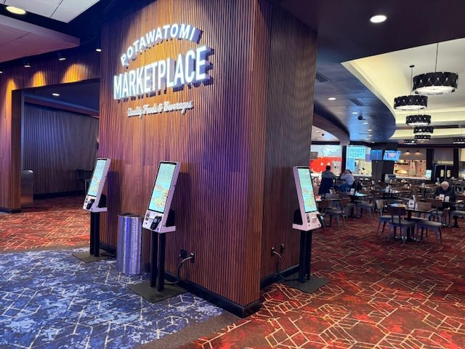
Food & Beverage – Self Service Kiosks

Slide 19
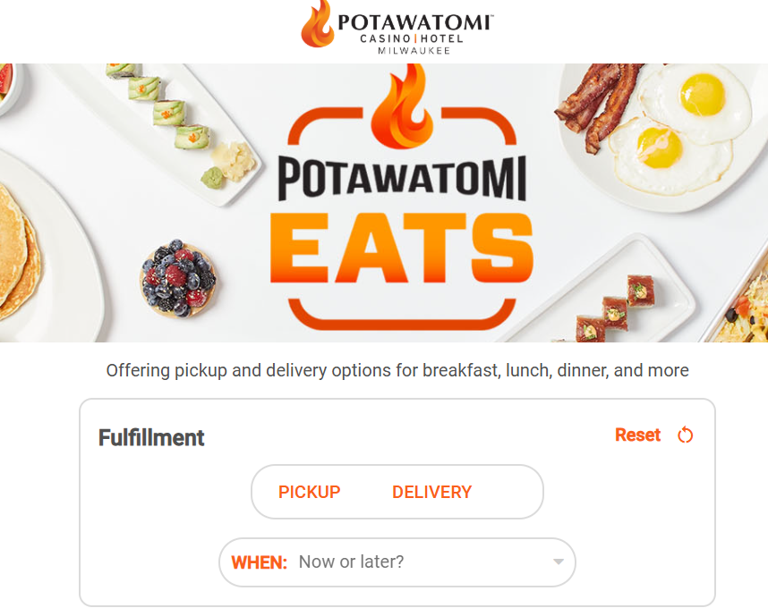

Slide 20
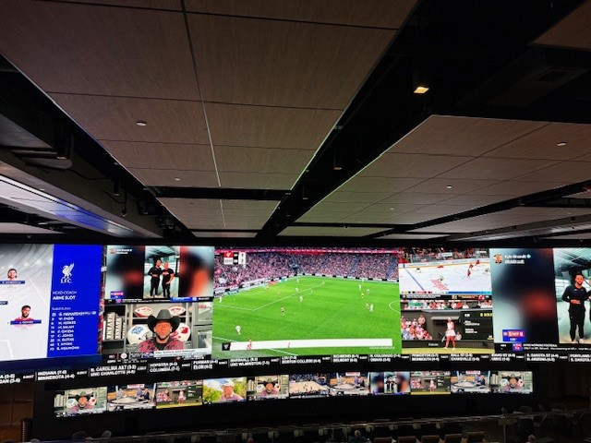
Potawatomi Sportsbook
2,000 square foot curved wall
4k resolution
4,384 panels
Each panel: 13 ½ inches tall x 6 inches wide
13 screen layouts
37 sports programs in 1 layout

Slide 21
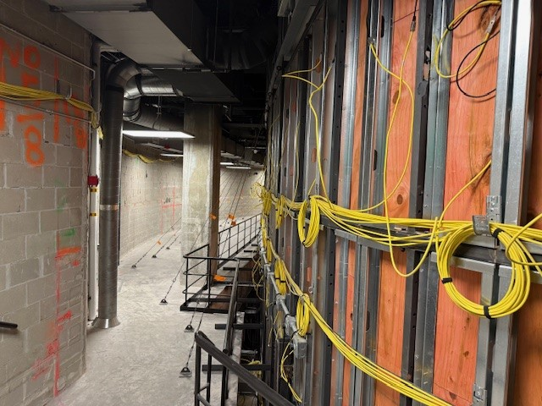
The Team
Potawatomi Casino Hotel
TaylorLED
AudioTek
CCCP

Slide 22
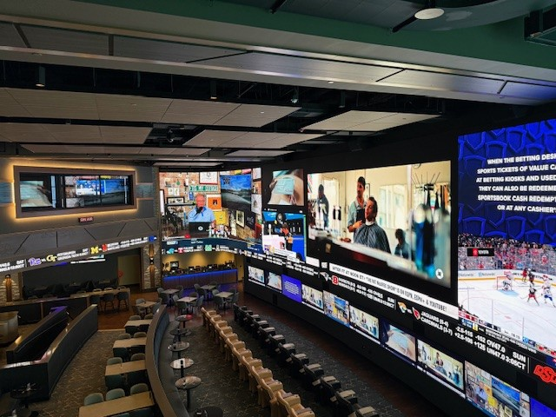
Sportsbook Broadcast Booth

Slide 23
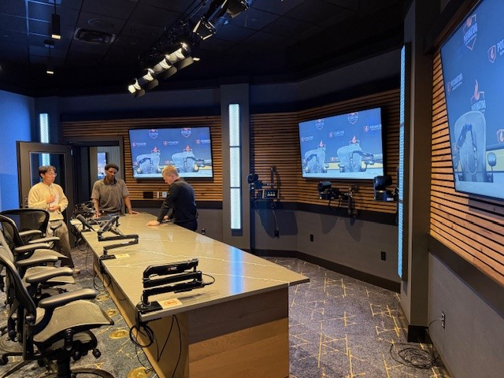

Slide 24
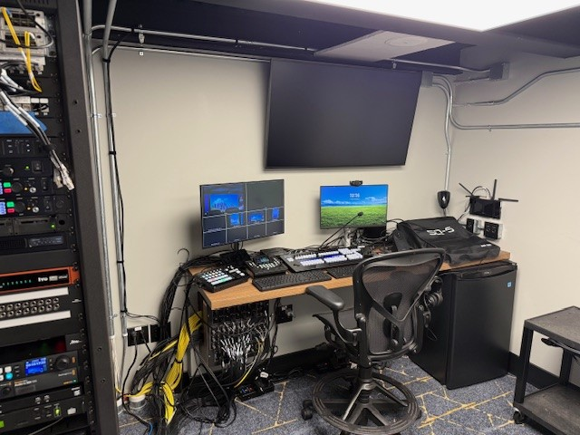

Slide 25


Q&A

