Slide 1
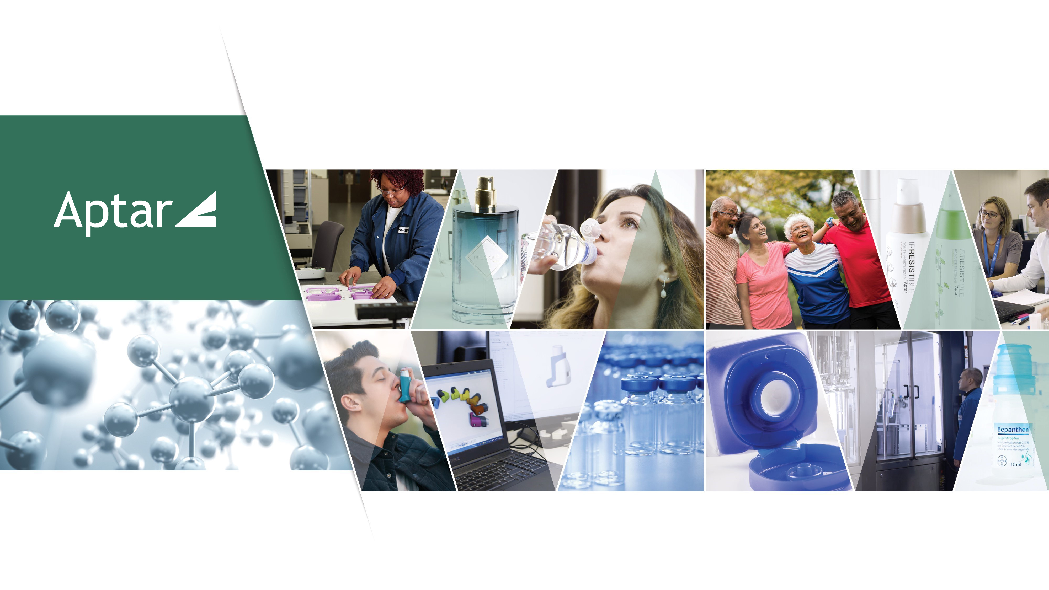
The Fast and the Curious: Turbocharging Software Teams
Derek Bressler | Senior Manager, Digital Customer Engagement | 8/14/2024

Slide 2
An Introduction to Aptar
Demystifying DevOps: A Manager’s Journey

Slide 3
Global Presence
Over 13,000 dedicated employees in 20 countries
Europe: 8,400 Asia/LATAM: 2,800 North America: 2,600
Demystifying DevOps: A Manager’s Journey
3

Slide 4
Markets and Regions
attractive growing end markets
FY 2023 NET SALES BY SHIP TO DESTINATION
EMEA
49%
Asia
10%
North America
33%
Latin America
8%

Slide 5


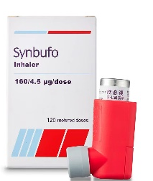
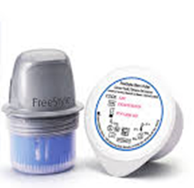
















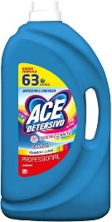









Millions of People Around the World Use our Products Every Day
5
Notes:
Our products and solutions are everywhere and part of our daily lives.
You should feel proud about working for Aptar as you’re truly making a difference in the lives, looks, health and homes of millions of people around the world.

Slide 6


Under the Hood: Setting the Context
16 years of expertise in the software development industry.
11 years of leadership experience in various domains:
  Regional Applications
  Manufacturing Execution Systems
  Software Engineering
  Digital Customer Engagement
Current Team Composition:
  2 DevOps Engineers
  5 Software Developers
  4 Software Engineers
  5 UX/UI/BA Analysts
  4 Data Engineers
  2 Software Testers
Note: The tips and tricks shared are based on my personal experiences and the specific needs of my organization. They may not be universally applicable but have proven effective in my context.
Demystifying DevOps: A Manager’s Journey

Slide 7

Shifting Gears: Macro Trends Impacting Dev Teams
Workplace Evolution
Remote Work / Distributed Teams
Diversity, Equity & Inclusion
Gen Z entering work force
Continuous Learning
Soft Skills
Fast Changing Business Env.
Agile Methodology
DevSecOps
Cyber Security
Cloud Services
Low-Code / No-Code
Native Apps vs. PWAs
AR and VR
Generative AI
Agility & Efficiency
Emerging Tech
Demystifying DevOps: A Manager’s Journey

Slide 8

Revving Up Team Spirit: Accelerating Cohesion in Remote Teams
    Lead with Empathy: People are our most important resource.
    Prioritize and schedule time for team social interaction & make an effort to discuss non-work topics: Coffee Roulette, Question of the week, Virtual Escape Rooms.
    Set an example: Turn on your camera consistently on conference calls and encourage others to do the same.
    Find unique ways to celebrate both personal and team achievements.
    Cultural Exchange Presentations: Assign employees to research aspects of the cultures of their colleagues and present.
Demystifying DevOps: A Manager’s Journey

Slide 9

Pit Stops for Progress: Prioritizing Skill Development
Assess & Monitor: Track skill gaps and reassess following training.
Incentivize Learning: Build training into the yearly objectives for both the manager and the employee.
Gamification: Host learning challenges with leaderboards and prizes.
Peer-led Training: Encourage team members to lead sessions on topics they are passionate about.
Cross Departmental Training: Facilitate training sessions between teams to facilitate understanding and collaboration.
Don’t Overlook Soft Skills: Leverage corporate programs to enhance communication & Organization.
Demystifying DevOps: A Manager’s Journey

Slide 10

Streamlined Performance: The Power of Lean UX & Kanban
Lean UX:
  Focus on User Experience: Prioritizes user feedback and iterative design.
  Rapid Prototyping: Quickly create and test prototypes to refine designs.
  Collaborative Approach: Encourages cross-functional team collaboration.
  Benefits: Faster design cycles, improved user satisfaction, reduced waste.
Kanban:
  Visual Workflow Management: Uses boards to visualize tasks and progress.
  Continuous Delivery: Promotes a steady flow of work without overloading team members.
  Flexibility: Easily adapts to changing priorities and requirements.
  Benefits: Increased efficiency, better task management, enhanced team transparency.
Demystifying DevOps: A Manager’s Journey

Slide 11

High-Octane Efficiency: Unleashing the Benefits of DevOps
Principles:
  Collaboration: Closer relationship between development and operations.
  Automation: Streamline repetitive tasks.
  CI / CD: Deploy the same way every time.
  Infrastructure as Code: Manage and provision infrastructure via code.
  Security: Integrate security throughout development life cycle.
Benefits:
  Faster Releases: Quicker delivery of features and updates.
  Higher Quality: More reliable and stable software.
  Increased Efficiency: Reduced manual work.
  Scalability: Easily adapt to changing needs.
  Faster resolution: Quickly identify and fix problems.
Demystifying DevOps: A Manager’s Journey
Notes:
Wordpress is the most used Content Management system in the world and as a technology does not have a company providing enterprise support (community support). For these reasons hackers target wordPress more than any other technology. It is a suitable technology for basic websites / online catalogs but is risky to use in more complex scenarios.

Slide 12

Full Throttle Future: The Impact of Gen AI
Using it Today:
  Enhance Code Reviews: Leverage tools like GitHub Copilot for first quality checks.
  Optimize Testing: Use it to create v0 Unit Tests & Suggest Test Cases.
  Improve documentation: Ask it to write documentation for provided code.
  Aid in Support: Summarize code & suggest root cause issues.
Adapting for Tomorrow:
  Focus on a higher level: Upskill resources for architectural design.
  Embrace the Business: Study business practices to better align strategic outcomes.
  Enhance AI Literacy: Maximize capabilities to leverage tools.
Demystifying DevOps: A Manager’s Journey

Slide 13

Questions? Feel Free to Reach Out!
Derek Bressler, Senior Manager – Digital Customer Engagement
Aptargroup, Inc. – www.aptar.com
Email: derek.bressler@aptar.com
LinkedIn: www.linkedin.com/in/derek-bressler

Slide 14

Disclaimer
This document, including all its sections, is protected by copyright.
Any use of the contents outside the narrow limits set by the copyright law is illegal and liable to prosecution if the author's permission has not been sought.
This applies in particular for reproducing, translating, microfilming, storing and processing the contents in electronic systems.
In addition, this document and any printed materials resulting from this document are confidential, should be used for internal use only and should not be shared with third parties without Aptar’s prior written consent.

Slide 15



Follow us on:
265 Exchange Drive
Suite 100
Crystal Lake, IL 60014
+1-815-477-0424
Aptar.com

