Slide 1
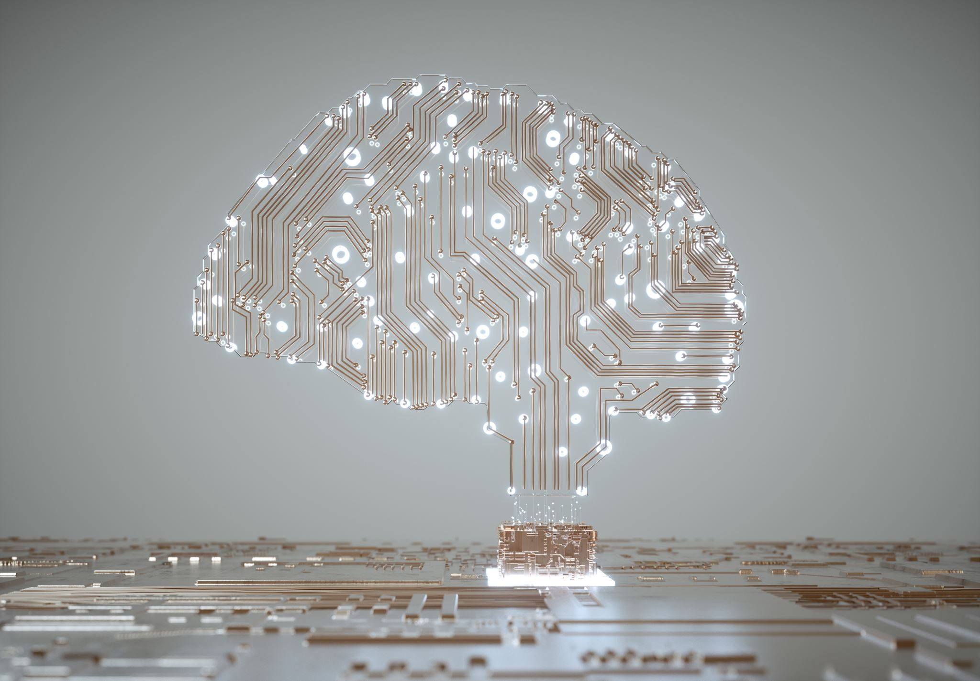
Generative AI Strategies on Platform & Cloud Engineering
Kyle Anderson
Sr. Director – Cloud
GE HealthCare

Slide 2
Introduction
GE HealthCare technology divesture from GE – standing up a Fortune 100 company from scratch
Massive transformation
Very real time and financial challenges
Shadow IT
Relatively lean cloud team with common challenges
Notes:
2 minutes
Show of hands, who can define Platform Eng
GEHC consumed significant traditional resources from GE in the past
Vending of empty clouds with guardrails and then it was the wild wild west
Business demands more maturity

Slide 3
Focus for the next ~20 minutes
Don't Expect:
Esoteric discussion about LLMs, training or ML
Discuss specific GAI platforms
Nuanced examples about GEHC
Tips to optimize your ChatGPT experience or "GAI Fails"
Anything more than a nod to SRE
Demos
Expect:
Define: Platform Engineering, GAI, (DevOps)
Common patterns that should apply to many organizations
A GAI strategy focused on cloud acceleration
The appropriate amount of buzzwords
A healthy amount of optimism
Notes:
2 minutes
This is where people dig out their phone or leave
Show of hands, who knows the generally-accepted textbook definition of Platform Engineering

Slide 4
Common Problems
Empty and Full Clouds
Everyone in a tech org thinks they're a cloud architect
  Everyone is prescriptive about their clouds
  Everyone communicates in BOMs not requirements or stories
In spite of Agile, work gets messy
Inefficient approach to standards – duplication of effort
Priorities, requirements and standards change
Multi-Cloud FTW!
Diversity of Technology
Notes:
3 minutes
Avoid complaining too much
Customize their clouds based on workload – subnets, routing, IAM, images, windows/linux, IaaS, Lambda, *ks
Don't be reductive of other disciplines
Work is difficult to manage without clean DevOps/SRE/PE boundaries
There are many ways to achieve the standards, and each team pays for it

Slide 5
Platform Engineering (PE)
DevOps has many problems.
Platform Engineering = Productized Paved Paths
Secure, Documented, Understood Framework
Adaptable and Scalable
Iterative - Follows SDLC
Consultative Customer Relationship with Reference Architectures
Control Planes and Abstraction Layers to keep people focused on application not cloud/infra
Notes:
3 minutes (11)
I'm going to assume many have heard of PE, people who attend conferences like this are more saavy, and it's not a new concept but it has been gaining ground in those dark and seedy social media circles
We've been doing PE for a while. Buy/Build paradigm software to skin clouds since private cloud days
Reference the forcing function of poor standards with pipeline-driven abstraction layers – app teams understand these abstraction layers
Focus on framework (Microsoft) aspect

Slide 6
Platform Engineering Team(s)
Fewer "Cloud" & "DevOps" people and more "Platform" people
Tier based on skills, not clouds or other silos
Fewer specialists, more generalists
Train and rebrand appropriately - Coach and Invest in Innovation
Collaborate with SRE & App Teams but do not integrate them
Platform Engineers/Architects behave more like SW Engineers
Notes:
2 minutes
These strategies hinge around people
Collaborate – don't demote people back to ops/devops

Slide 7
Enter: Generative AI (GAI)
Paradigm shift
  Leveraging is novel now, mandatory in the future
  Potential long-term impacts on people's careers
  Elevates capable engineers and architects
  GIGO - GAI is reflective of the people using it
Very foggy crystal ball – Star Trek or Terminator?
It generally works* - Anticipate Maturity
GAI understands much and knows nothing
Notes:
3 minutes
Reference how this is analogus to Google.
Tell the anecdote about my boss googling "bicep and arm" and getting pictures of body parts
Need and demand is a forcing function of maturity
GAI and the calculator analogy

Slide 8
A list of things I no longer care about
Terraform, Bicep, CloudFormation, ARM
Ansible, Chef, Puppet, bash, powershell
Github Actions, Gitlab-CI, Jenkins, Azure DevOps, AWS CodeDeploy
Python, Java, Go, Rust, SQL Queries, Kotlin
AWS, Azure, GCP, OCI
Cloud Certifications!
X number of years of experience in any of the above
Notes:
2 minutes tops
Note: I really don't care about clouds. New forcing function We'll want to move workloads closer to GAI GPUs
I care about some of these things a little, it's a casual relationship not a marriage
I'm not sending my staff to training on terraform

Slide 9
Things I now care about
The Customer Experience
Pragmatic Results
Engineers and architects that use GAI to design and build solutions
My ever-growing Service Catalog(s)
Functional, extensible code and APIs
A robust backlog and roadmap the C-Suite can invest in
KPI: our ability to adapt and change
Open-mindedness when building roadmaps
Notes:
3 minutes (21)
It's not sausage-making anymore. The customer needs to understand and use my products.
Talk about interview tactics – project for engineers

Slide 10
Productization
Interact with your customers to establish a roadmap – including SRE
Start small and iterate
Keep clear of edge cases
You will likely have many products, scope and plan appropriately
Assume GAI will become more prolific in all interactions
Understand how your service catalogs relate to your products
Innovate & Rebuild!
Reduce/Eliminate "Ready to Work" staffing perception
Notes:
2 minutes
Focus on documenation and rebuilding

Slide 11
Combining PE and GAI
Demand excellent documentation as part of acceptance criteria
Put Chat/Cognitive Search in front of documentation
Pipeline Driven - Pragmatic, Modular, Combinative
Don’t attempt to boil the ocean
Anticipate maturity to grow in the marketplace to meet our needs
Establish metrics to validate engineering success
Embrace the polyglot!
Notes:
2 minutes
Extensive IaC and CM pipelines, more steps

Slide 12
Common Solutions
Empty and Full Clouds (Rebuild)
Everyone in a tech org thinks they're a cloud architect (Productize)
In spite of Agile, work gets messy (SRE)
Inefficient approach to standards (Productize)
Priorities and standards change (Productize)
Multi-Cloud (GAI)
Diversity of Technology (GAI)
Notes:
2 minutes

Slide 13
Challenges
Legal & Security
Predicting the future
Embracing PE and GAI as a team & company
Slowing down to go faster
Clients and Customers
Intransigent Individuals and Teams
GAI date cutoff and other challenges
Notes:
2 minutes

Slide 14
Discussion and Q&A

Slide 15
Appendix
Cloud vendors and GAI

