Slide 1
Data as a Product
nvisia Insights
October 9, 2024

Slide 2




Tracey Barrett
SVP, Products & Services
tbarrett@nvisia.com
Claims Modernization
Patient Bedside Monitor
Patient & Clinician Portals
Mobile Tax Prep
Benefit System Modernization and
Agile Introduction
Tornado Warning System
Telehealth Platform

Slide 4
Here’s what we do.
In every category, we have:
Experts and advisory services to help you plan
Case studies to demonstrate experience
Intellectual property to jumpstart efforts
Product partnerships & certified consultants
Events, training & thought leadership
Software Product Development
Customer + User
Experience
AI, ML + Data
DevOps +
Platform

Slide 5
Who are you?
Notes:
Who comes from the Product Management or Business side of their org?
App Dev?
Infrastructure or operations?
Data?

Slide 6
What this talk will cover
A new, more agile approach to managing data in the enterprise
Starting with the current problems and why a change is needed
Enough architecture to “get the picture”
Dig into the product approach and the role of product managers
Discuss transformation steps

Slide 7
Introduction
The demands of the AI age

Slide 8


Slide 9
Product development teams are coming for your data.

Slide 10

Agile people are coming for your data.

Slide 11
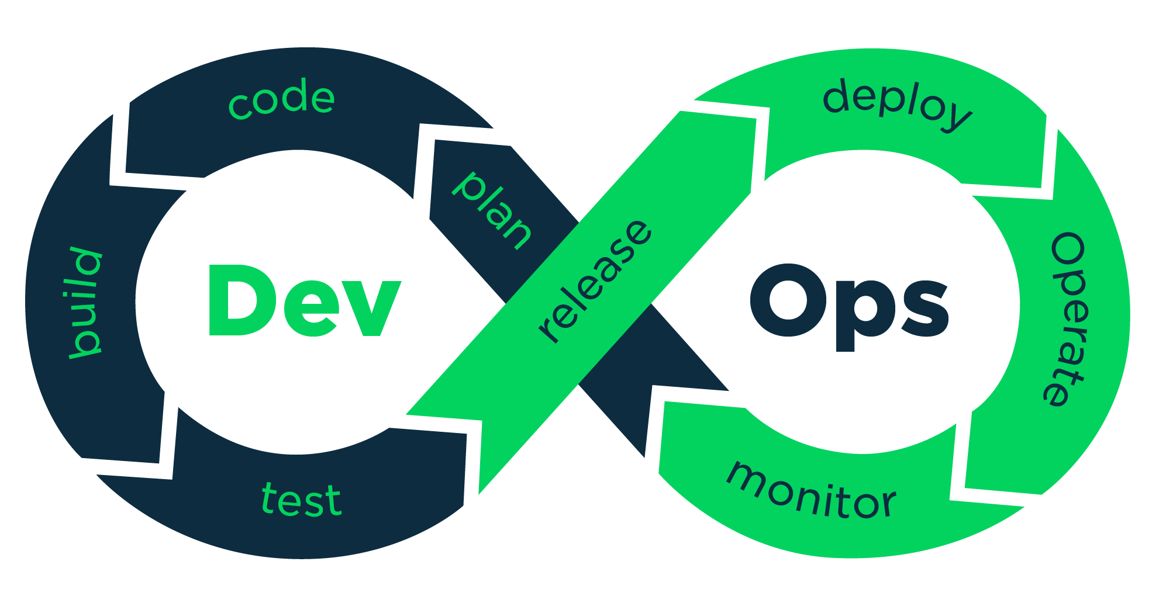
And just like what happened with infrastructure, we won’t be satisfied with the current state of affairs.

Slide 12
We’re going to demand:
Realtime access and notifications
To AI-processed and augmented data
From across the entire enterprise
Available within a sprint

Slide 13
Doing this will require a whole new way of thinking about data.

Slide 14
Current state
Siloes, redundancies & point-to-point integrations

Slide 15
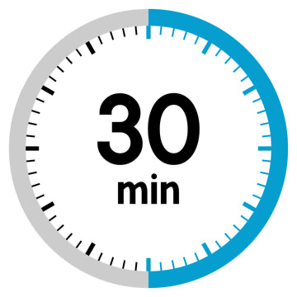

Slide 16

First, let’s give the data people some grace.

Slide 17

Nascent tools & processes for
data science, engineering and AI

Slide 18
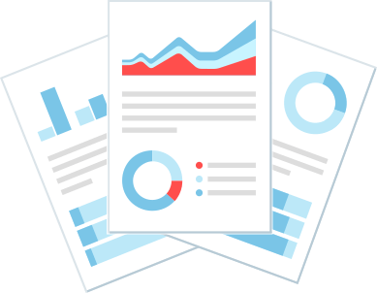
Data requirements have primarily been driven by reporting.

Slide 19

App dev & data are siloed

Slide 20



Slide 21
Lots of redundancies
Reports duplicate data transformation rules
Data analysts and scientists don’t have good ways of sharing their findings, so they repeat them
Data engineers repeat their transformations
Very little but the raw data is reusable

Slide 22
Tool-based projects haven’t spurred adoption.

Slide 23
Data as a Product
What is it?

Slide 24

To define this, we need to consider:
What’s in the box?
Who are my customers?
Who’s on the product team?
What process do they follow?
How do we measure success?

Slide 25

What’s in the box?
Define your data products as “golden record versions” of the key domains in your organization.
Examples:
  Customer
  Product
  Order
  Vendor

Slide 26
What’s in the box?
Extended with all the bells and whistles, aka, augmented data.
Examples:
  Customer: sentiment
  Product: profitability analysis
  Order: cross-sell recommendation
  Vendor: effectiveness ranking

Slide 27
What’s in the box?
Include the accessories and supporting documentation.
Examples:
  Metadata / data catalog
  Restful API
  Event subscription

Slide 28

Who are the customers?
Reporting teams
App dev teams, using enterprise data
Data scientists and engineers, using and enhancing enterprise data
External companies: customers & vendors

Slide 29

Who’s on the team?
Product manager
Data scientists / analysts
Data architect(s)
Data engineer(s)

Slide 30

What process do they follow?
Agile process
Long-standing team, continuously improving and continuously adding features
Working a prioritized backlog
Delivering frequent, incremental value

Slide 31
How do we measure success?
Adoption.
  “Are other areas using our services?”
  Extremely important to watch in any sort of organizational change initiative.
Cycle time.
  “How quickly can we respond to requests?”
  The ultimate goal. Delivering high-quality data sooner, right where it’s needed.

Slide 32
Organization
What’s the structure?

Slide 33
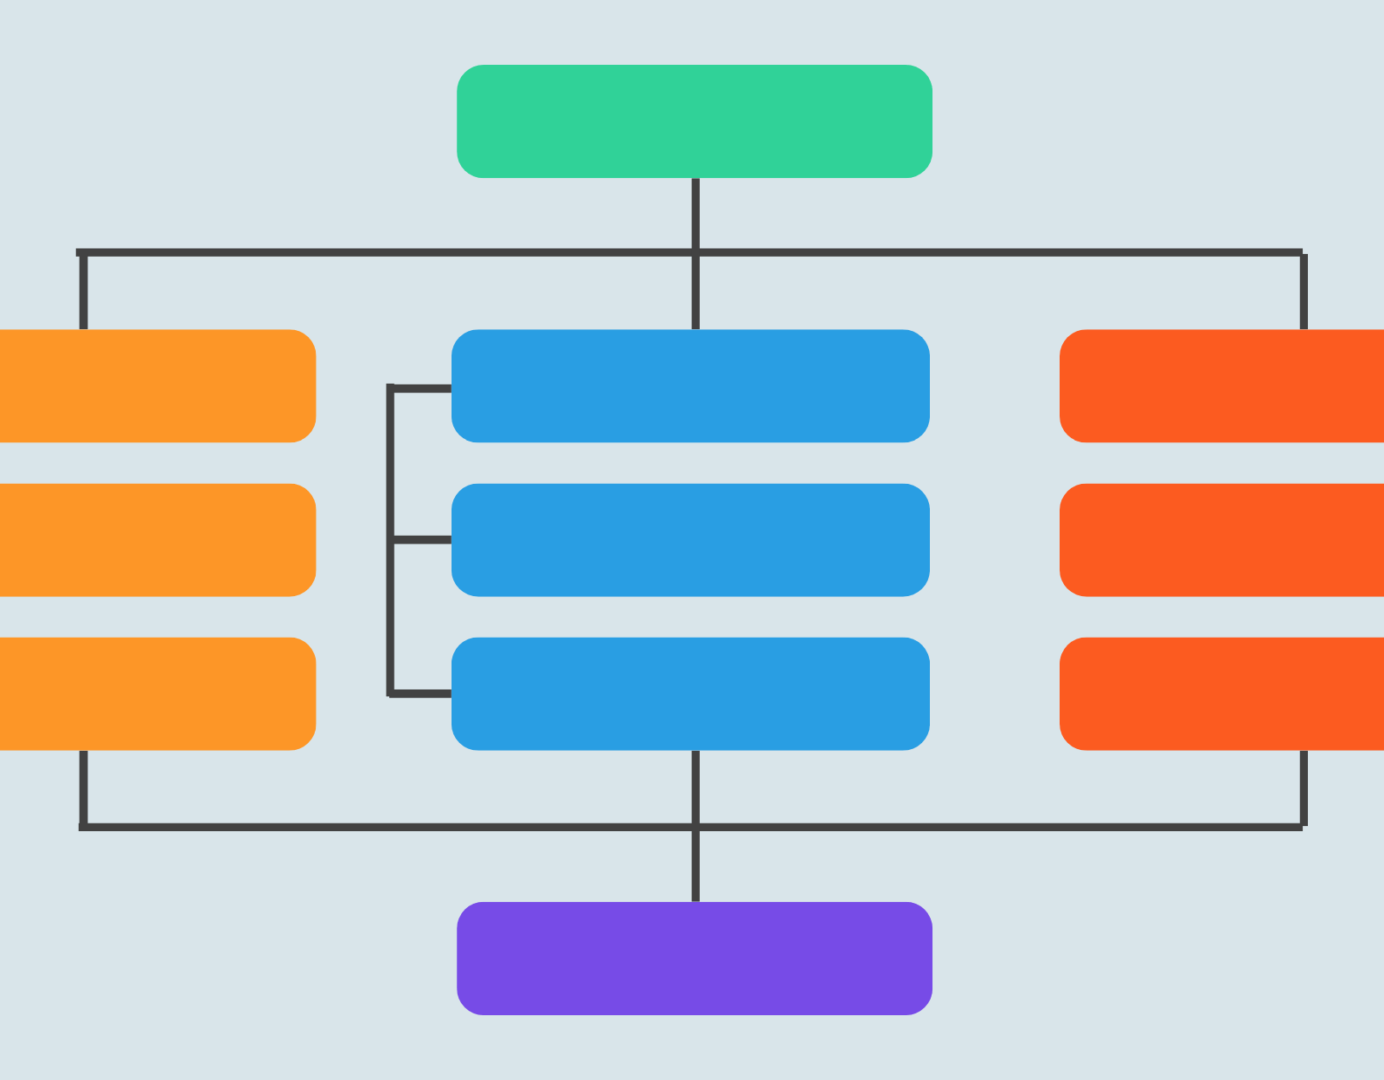
Typical approach
Center of Excellence lives in IT.
  Shared tools and standards
  Recommended architectural approaches
Product teams in the business.
  A successful model is to incubate these teams in IT and then move then to the business unit once they are effective.

Slide 34
Architecture
A view of DaaP

Slide 35

Data at the center of your architecture
Example architecture on Azure platform
Azure Databricks
Operational
Systems
Read from gold
Gold
Read from gold
Power BI
Silver
Operational
Systems
Bronze
Work directly with the system
Feed to bronze
Data scientists & engineers

Slide 36
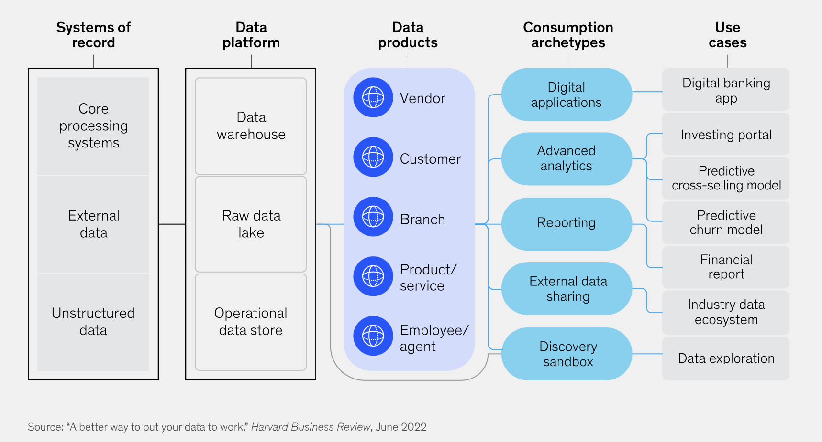

Slide 37
Did we hit the goal?

Slide 38
We’re going to demand:
Realtime access and notifications
To AI-processed and augmented data
From across the entire enterprise
Available within a sprint

Slide 39


Slide 40


Keep the conversation going:
Tracey Barrett
SVP, Wisconsin
tbarrett@nvisia.com
Thank you!
tbarrett@nvisia.com
https://www.linkedin.com/in/traceycbarrett/
https://www.meetup.com/Milwaukee-Agile/

